Slide 1

Servant Leadership for officers and other Masonic leaders

Slide 2

Questions to consider:
Where have you had access to training as a leader?
What have your experiences been with different kinds of leaders?
What are some of the best memories you have from interacting with those in power?
What are some of the nightmares you've experienced while dealing with those in power?
What do the lessons of Freemasonry teach us about leadership?

Slide 3
The nature of Freemasonry, the organization
All volunteer
Pseudo-autocratic
Limited transparency when making decisions
Limited accountability

Slide 4
Masonic charges
Maintain the best interest of the fraternity
Assumes a thorough knowledge of the philosophy of Freemasonry
Altruistic motives

Slide 5
Available tools are limited
No pay raises
No vacation packages
No bonuses
No threats to livlihood

Slide 6
Opportunities for leadership
Formal positions and authority
Informal positions and authority

Slide 7
Access to training?
Mostly self-taught
Some formal training programs
All include humility, relationship development, and helpful methods

Slide 8
Servant leadership by Greenleaf
Listening
Empathy
Healing
Awareness
Persuasion
Conceptualization
Foresight
Stewardship
Commitment to the growth of others
Building community

Slide 9
Servant leadership
Not a boss or dictator
Supporter
Facilitator
Empowering those around them

Slide 10
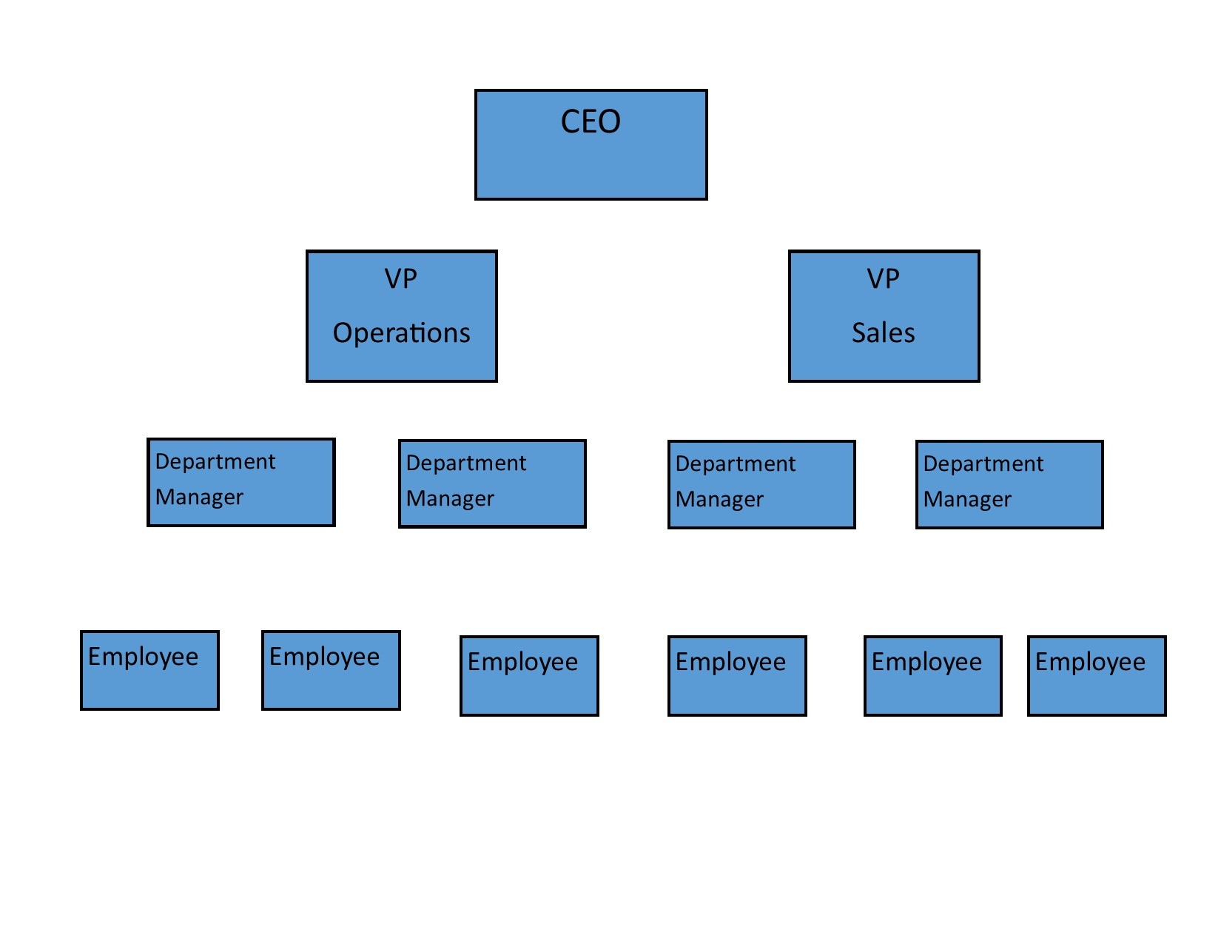
Corporate table of organization

Slide 11
Servant table of organization

Slide 12
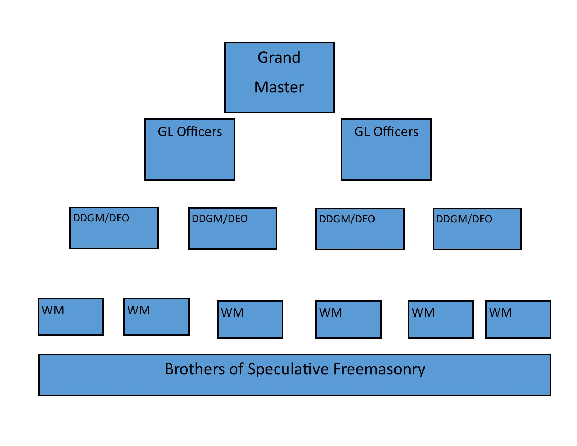
Masonic table of organization

Slide 13
Servant Masonic table of organization

Slide 14
Experiences with leaders
Teacher, Coach, Parent, Relative
Supervisors, Bosses, Co-workers
How they should/could be done
What not to do!

Slide 15
Memories both good and bad

Slide 16
Teachings of Freemasonry
How to be good men
Role models in our Lodge and community
Few direct and specific teachings
General principles that can be helpful

Slide 17
The Cop
Spot violations
Affirmation of expertise
Opinions = Facts
Confidence leads to arrogance
Demands perfection
Mired in the details
Loses ‘big picture’
Becomes a bully

Slide 18
The Cop
Resentment, Fear, Compliance
Polite acquiescence
Discounted after the fact

Slide 19
Best Friend
Likes ceremony, recognition, ‘bling’
Welcomed
Social
Friendly
Soft approach to problems when spotted
Makes no waves

Slide 20
Best Friend
Overlooks opportunities to teach
Lets problems slide
False impression of all being OK
Allows mediocrity to persist

Slide 21
Good Coach
Role Model
Respected based on past performance
Quality relationships
Thorough knowledge of code and ritual
Understands to philosophy and teachings
Offers support and teaching, not criticism

Slide 22
Good Coach
Knows the rules
Does not overlook problems
Enforces when needed without excess
Admonishes without being demeaning or insulting
Must be thoughtful

Slide 23
Good Coach
Recognition, honors, titles secondary to service to the Craft
Sets aside personal goals for the greater good
Willing to revel in the success of others

Slide 24

Shameless Commerce
Macoy Masonic Publishers
www.macoy.com
https://www.macoy.com/Masonic-Bible-Masonic-Books/Masonic-Books-on-Managing-a-Lodge/The-Purple-of-the-Fraternity-A-Handbook-for-DDGMs-Grand-Lodge-Officers

